Slide 1


LIBERIUM CRYPTO

Slide 2

Liberium Objectives
To provide a platform for the easiest
crypto trading on the planet.
To gather a massive number of Affiliates to
grow our customer base.

Slide 3
LIBERIUM CRYPTO
SERVICE
OFFERING
LIBERIUM CRYPTO

Slide 4
  The Basics
Users maintain possession of their crypto assets 100% of the time.
Users keep 100% of the trade results.
Real crypto trades in YOUR exchange initiated by real, professional traders
There are no commissions on trades or deposits.
Customer’s settings control the time/profit through the custom trailing stop
Make profits from the signals, automatic trading and/or making referrals
There are no size limits on trades or referral earnings.
Automatically Buy Low then Sell High

Slide 5
  2 Options for Starting
Fully Automated Trading
- Get trade tokens / trade credits used to open a trade
- When a Trader makes a trade, our system makes a new trade in the individual exchange of everyone following that trader
- Every buy order and corresponding sell order is automatic
- The more trade credits / tokens you purchase the better the value.
- The only difference in the packages is the price per trade credit
- Users can set their own custom trialing stop
- BTC / Alt coin pairs OR USD (or USDT) / All crypto
Signals
- Notifications are emailed when traders make a new buy order and sell order.
- Users manually execute their own trades in their exchange
- This is a monthly subscription

Slide 6

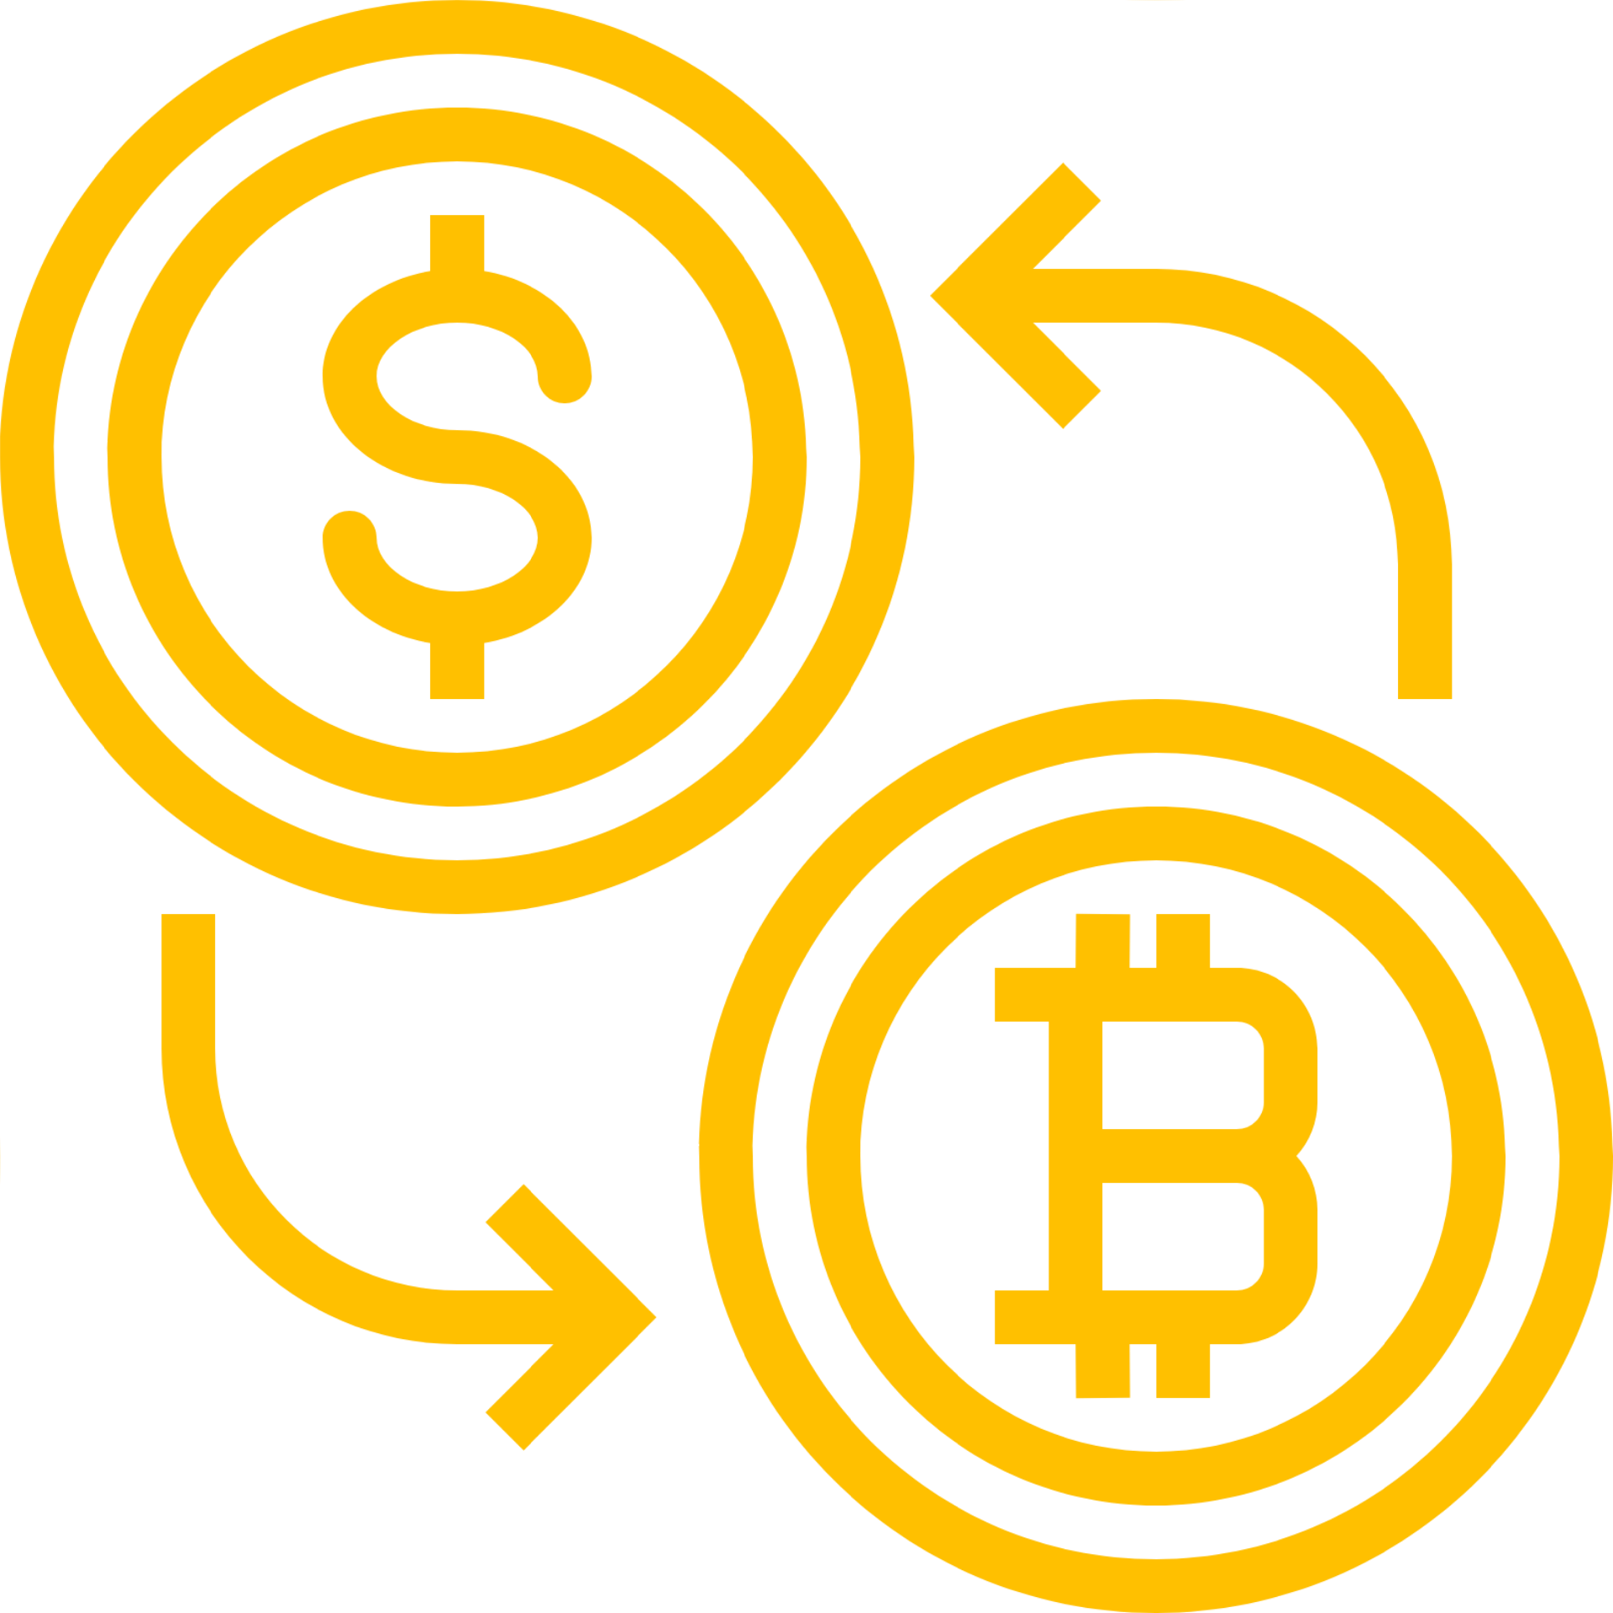



HOW TO SET UP YOUR ACCOUNT
LIBERIUM CRYPTO
Follow step-by-step instructions on the Dashboard
A
B
C
D
E
Cryptocurrency wallet
Exchanges KuCoin
Binance.com
Kraken
Gemini
Select Trade
Package
Pay BTC, LTC, Doge
API Code and Private Code from Exchange
Select a Pro Trader to Copy

Slide 7
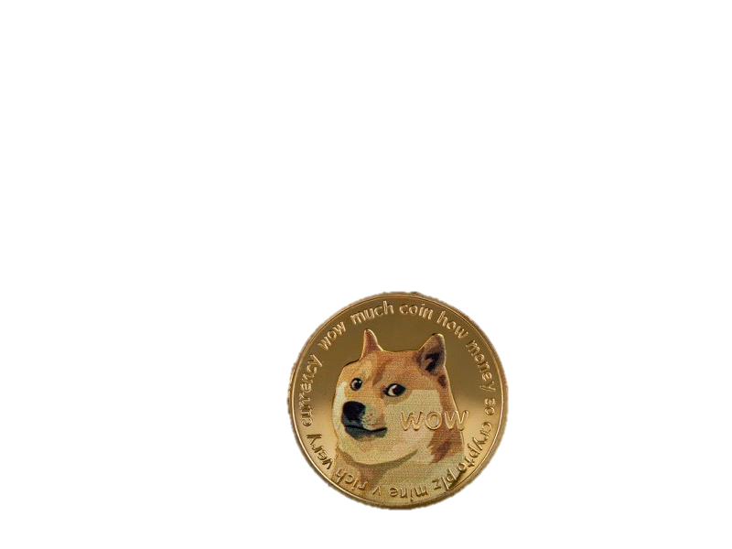
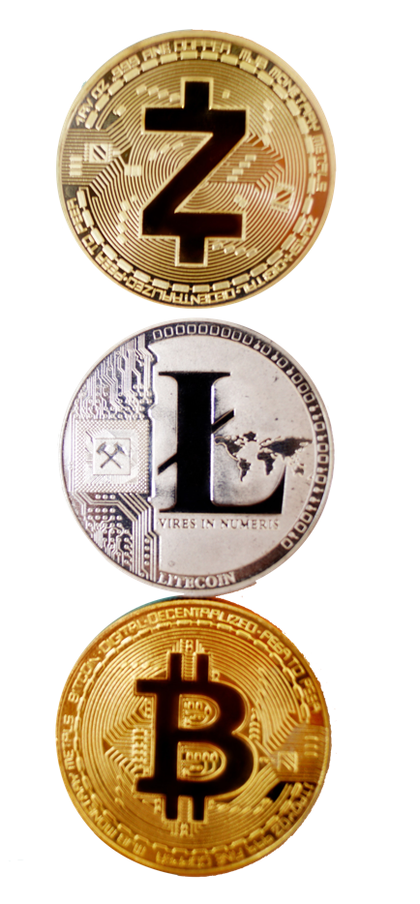
Trade Packages (Hands Off)
Bitcoin, Litecoin, or Dogecoin
Trading Package USD Price Credits Value
Liberium $755 1140 40% extra tokens
(Best Value)
Peace $567 730 30% extra tokens
Justice $379 420 11.4% extra tokens
Veritas $189 189 Standard
Trade Signals $79 Monthly Subscription*

Slide 8
  Q: How Liberium Crypto Stands Out?
Liberium Crypto is the ONLY place to get a pro trader to make trades for you, without a commission, where you keep the results of the trade, you maintain control of your crypto assets and have the perfect power of a custom trailing stop loss. We are the only company offering a customizable trailing stop that allows customers to choose a minimum profit while also allowing for more upside side potential.
The Custom Trailing Stop will trigger once desired profit is met. It will sell once the price starts to drop but it will also provide the opportunity for the price to continue to go up. So even if your custom trailing stop setting is for example 4%... the Liberium Crypto system could sell the trade and 7%...10% or higher but only sell it when the price starts to drop again. Perfection.

Slide 9
LIBERIUM CRYPTO
AFFILIATE
PLAN
LIBERIUM CRYPTO

Slide 10
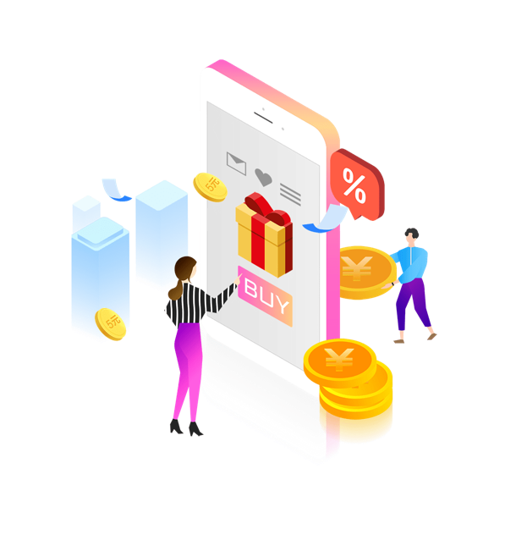

Liberium Package - Best Value $755
1140 trades
Direct and Indirect Commissions
You can have unlimited number of Personal Referrals. 1 paid referral will qualify you for Direct Referral commissions
and Level 2 Indirect Referral commissions. Referring 3 customers qualifies you for ALL 20 LEVELS of referral commissions.
1st (Direct) $240
6th Level $20
2nd Level $60
7th Level $16
3rd Level $40
8th – 10th $12
4th Level $20
11th – 14th $8
5th Level $40
15th – 20th $4

Slide 11
Peace Package - $567
730 trades
Direct and Indirect Commissions
You can have unlimited number of Personal Referrals. 1 paid referral will qualify you for Direct Referral commissions
and Level 2 Indirect Referral commissions. Referring 3 customers qualifies you for ALL 20 LEVELS of referral commissions.
1st (Direct) $180
6th Level $15
2nd Level $45
7th Level $12
3rd Level $30
8th – 10th $9
4th Level $15
11th – 14th $6
5th Level $30
15th – 20th $3

Slide 12
Justice Package - $379
420 trades
Direct and Indirect Commissions
You can have unlimited number of Personal Referrals. 1 paid referral will qualify you for Direct Referral commissions
and Level 2 Indirect Referral commissions. Referring 3 customers qualifies you for ALL 20 LEVELS of referral commissions.
1st (Direct) $120
6th Level $10
2nd Level $30
7th Level $8
3rd Level $20
8th – 10th $6
4th Level $10
11th – 14th $4
5th Level $20
15th – 20th $2

Slide 13
Veritas Package - $189
189 trades
Direct and Indirect Commissions
You can have unlimited number of Personal Referrals. 1 paid referral will qualify you for Direct Referral commissions
and Level 2 Indirect Referral commissions. Referring 3 customers qualifies you for ALL 20 LEVELS of referral commissions.
1st (Direct) $60
6th Level $5
2nd Level $15
7th Level $4
3rd Level $10
8th – 10th $3
4th Level $5
11th – 14th $2
5th Level $10
15th – 20th $1

Slide 14
Signals Package - $79
1 month of Signals
Direct and Indirect Commissions
You can have unlimited number of Personal Referrals. 1 paid referral will qualify you for Direct Referral commissions
and Level 2 Indirect Referral commissions. Referring 3 customers qualifies you for ALL 20 LEVELS of referral commissions.
1st (Direct) $15
2nd Level $7
3rd Level $5
4th Level $3
5th Level $10

Slide 15
Infinity Bonus
In Additions to Direct and Indirect Commissions
In addition to the Direct (Level 1) and Indirect Commissions (Level 2 through 20), you can qualify for the Infinity Bonus by referring 15 Customers. That bonus is either $10, $20, $30, or $40 depending on the package purchased. The Infinity Bonus goes to the first person that is qualified to receive it. It is not based on Levels so it could happen to come from a Direct Referral or from a new customer 1,000 Levels from you.
Liberium $40
Peace $30
Justice $20
Veritas $10
Signals $10

Slide 16

LIBERIUM CRYPTO
As with any business, your results may vary, and will be based on your individual capacity, work, business experience, expertise, and level of desire. There are no guarantees concerning the level of success you may experience. Any testimonials and examples used are exceptional results, which do not apply to the average purchaser, and are not intended to represent or guarantee that anyone will achieve the same or similar results. Each individual’s success depends on his or her background, dedication, effort put forth, desire and motivation.

Slide 17
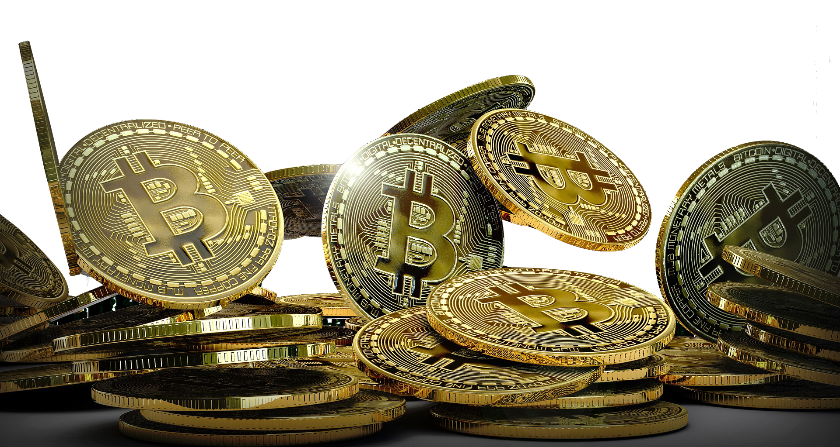
THANK YOU

